Slide 1
UiMagician Porting Guide

Slide 2
1
Device Details
code : writing/Reading from pop-up widget

Slide 3
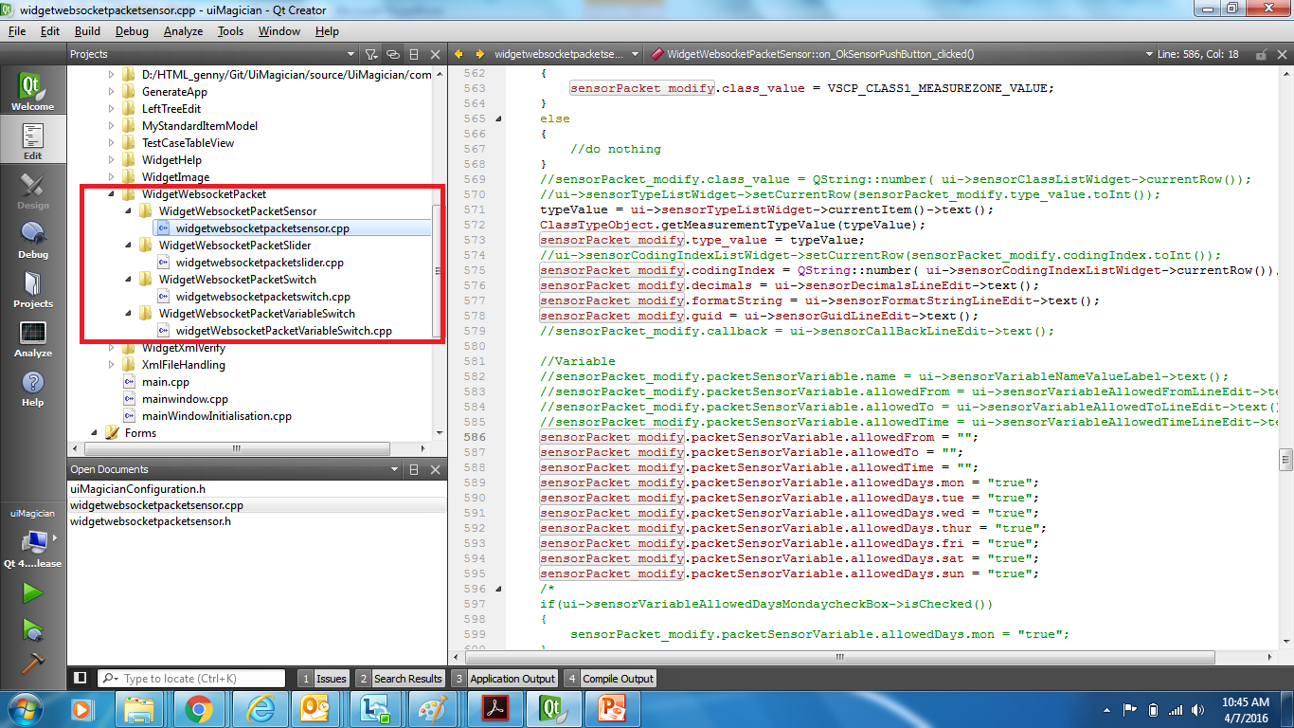

Slide 4
1
Device Details
GUI : pop-up widget -- modification

Slide 5
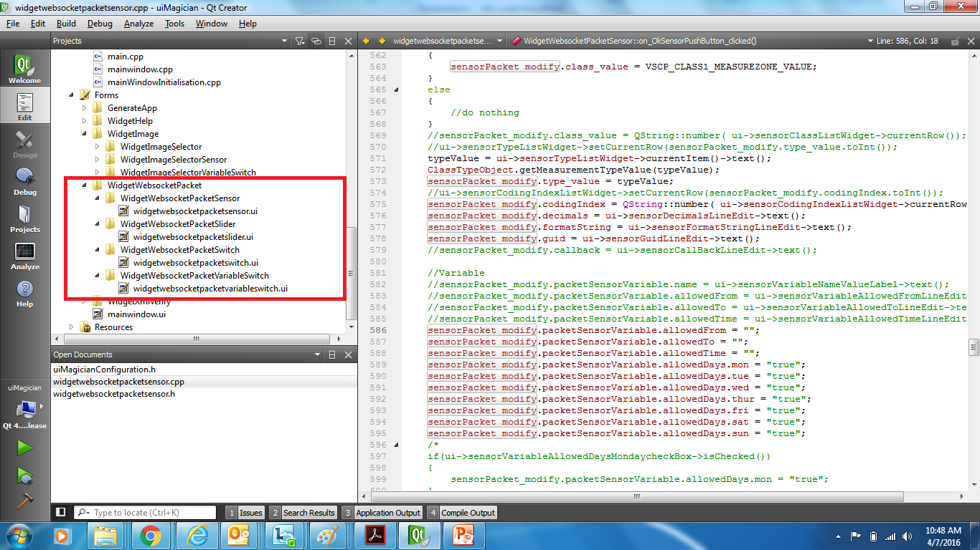

Slide 6
2
Image details
code : pop-up widget -- modification

Slide 7
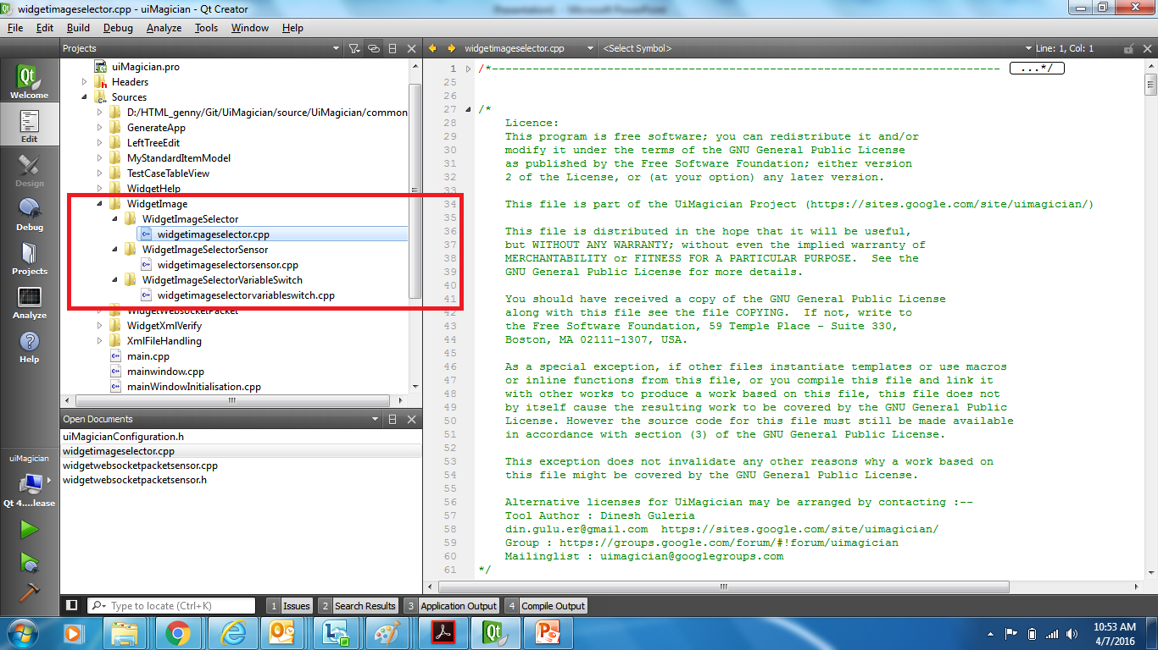

Slide 8
3
XML Reading – node value

Slide 9
XML Reading – node value
File mainwindow.cpp :--
File xmloperation.cpp :--
- UpdateTextViewForCurrentSelectedNode
-- xmlReadFullRoomNodeValue
-- UpdateListForvscpPacket() ---> this is the target --> file xmloperation.cpp

Slide 10
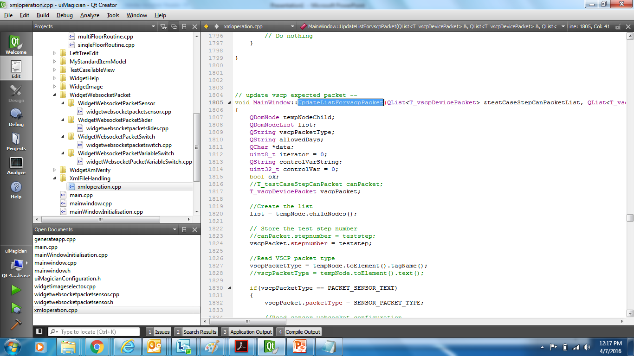

Slide 11
4
XML Writing – node value

Slide 12
XML Writing – node value
File mainwindow.cpp :--
- on_testCaseNewPushButton_clicked()
File mainwindow.cpp :--
File mainWindowInitialisation.cpp :--
- on_testCaseSavePushButton_clicked()
--xmlAppendFullTestStepsToTestCase
--- xmlCreateTestStepNode
---- xmlCreateVscpPacketNode() ----> this is the target --> file xmloperation.cpp

Slide 13
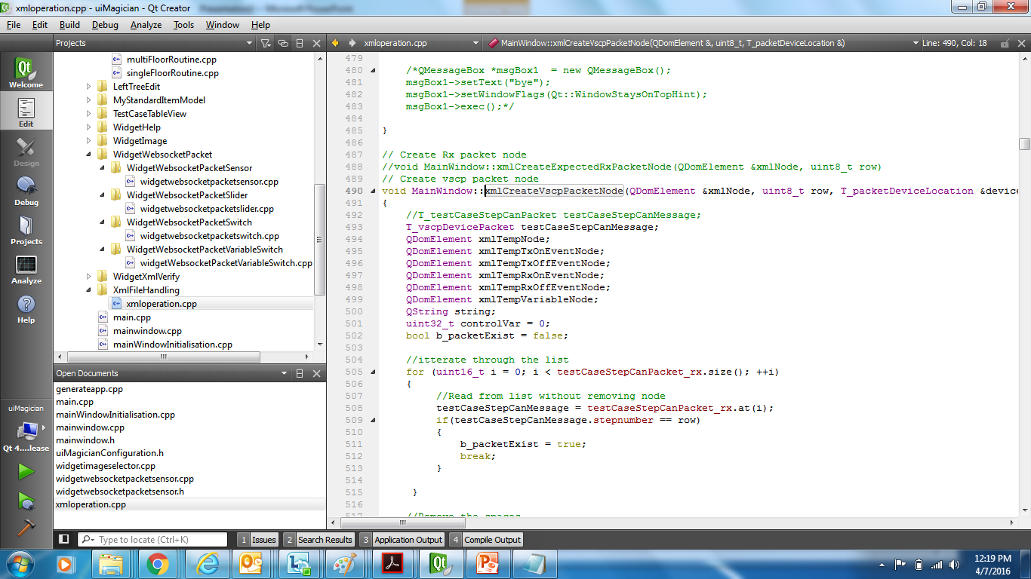

Slide 14
XML --> JS file conversion

Slide 15
XML --> JS file conversion
File : generateapp.cpp
File : singleFloorRoutine.cpp
File : multiFloorRoutine.cpp
Modify variables related to socket configuration file :--
FloorsSwitchSocketCfgFileString
FloorsVariableSliderSocketCfgFileString
FloorsVariableSwitchSocketCfgFileString
FloorsSensorSocketCfgFileString

Slide 16
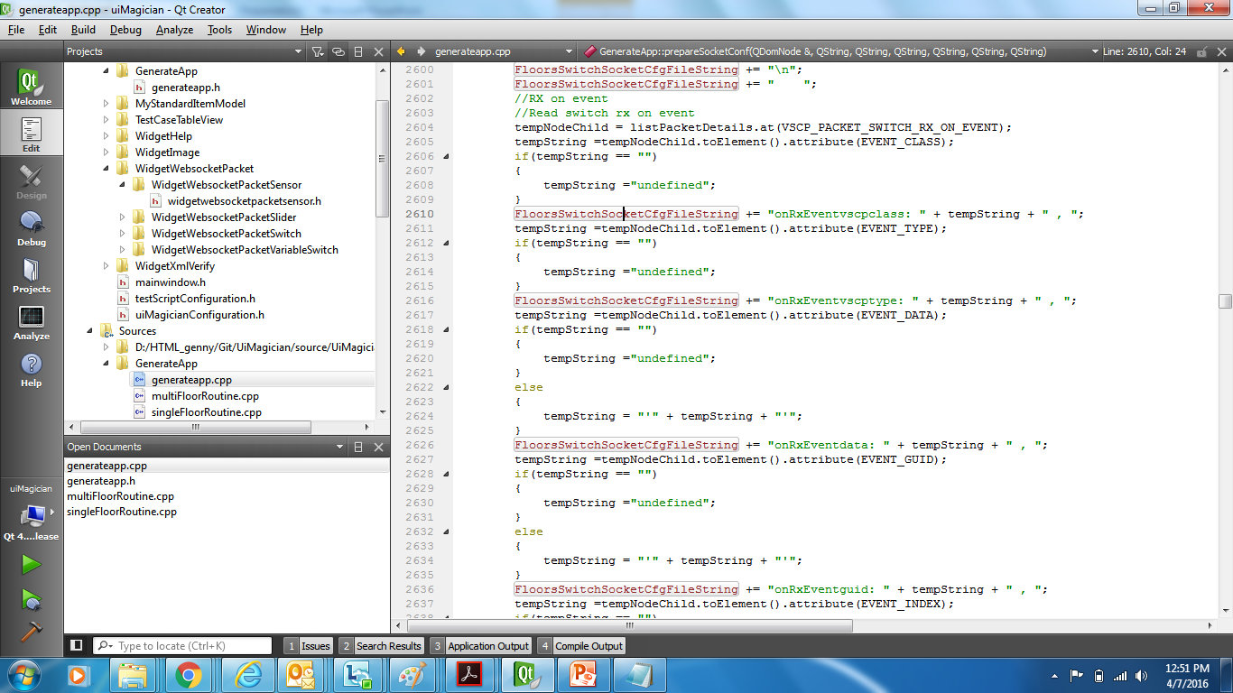

Slide 17
EOF

